Slide 1
Digital marketing project Phase 2

Slide 2
Presented by
TEAM LEADER
T.NANDINI
TEAM MEMBERS
S.RUPESH
V.PRAVEEN KUMAR

Slide 3
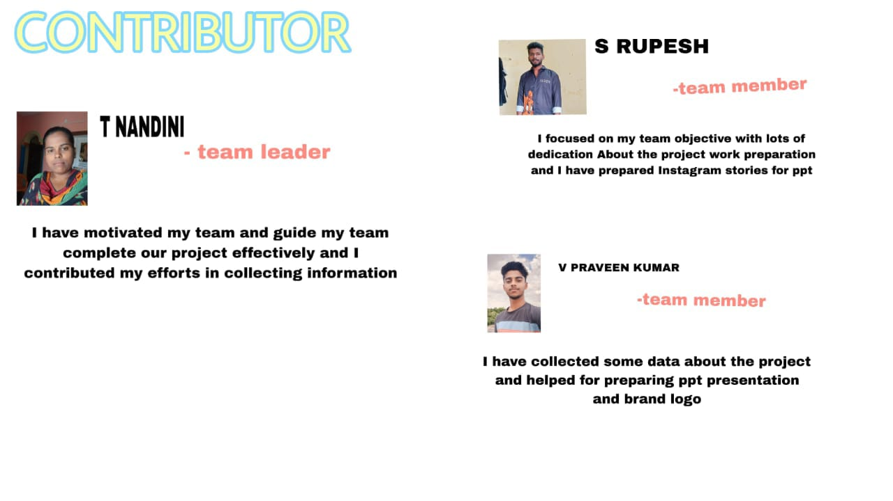

Slide 4
INTRODUCTION OF WIPRO COMPANY
Wipro limited (formerly western India products limited)is an IT services and consulting company headquartered in Karnataka, Indi.
As of 2012,Wipro is the second largest IT services company by turnover in India, employing about 120,000 people worldwide as of December 2011.
Provides out sourced research and development, infrastructure outsourcing, business process outsourcing (BPO) and business consulting services.
Wipro is a one of Indians largest publicly traded companies and seventh largest IT services firm in the world.
Wipro is the leading strategic IT partner for companies across India,the middle east and Asia-pacific-offering integrated IT solutions.

Slide 5
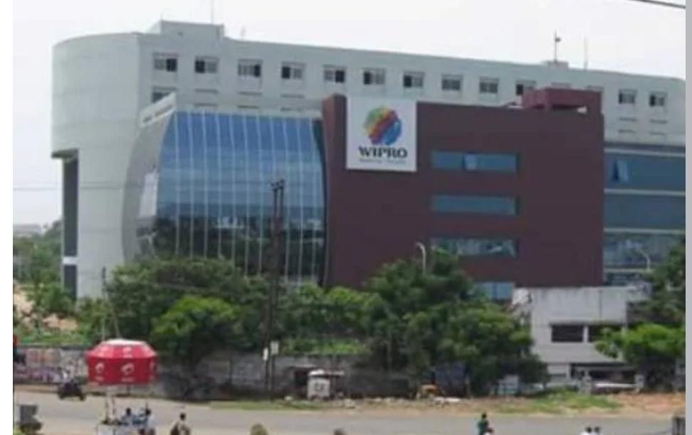

Slide 6
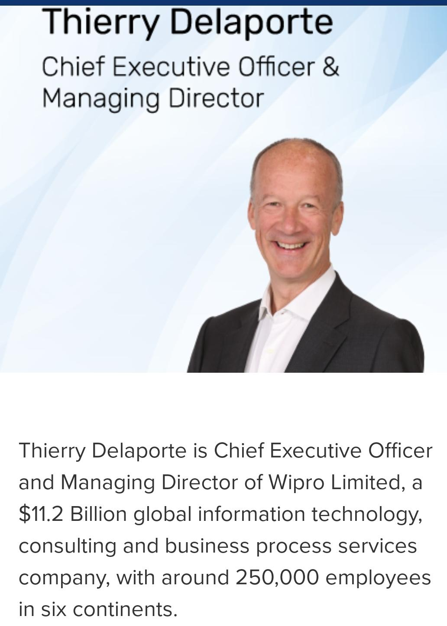

Slide 7
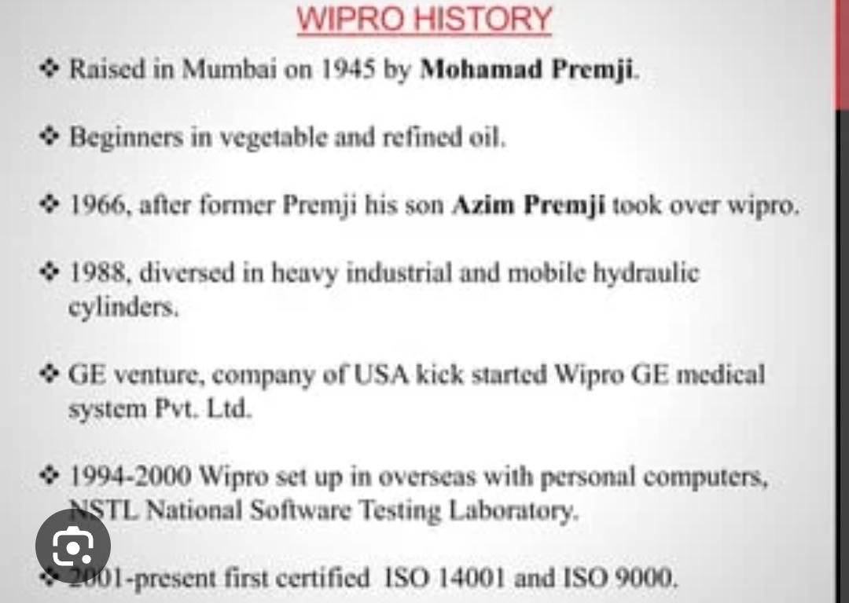

Slide 8
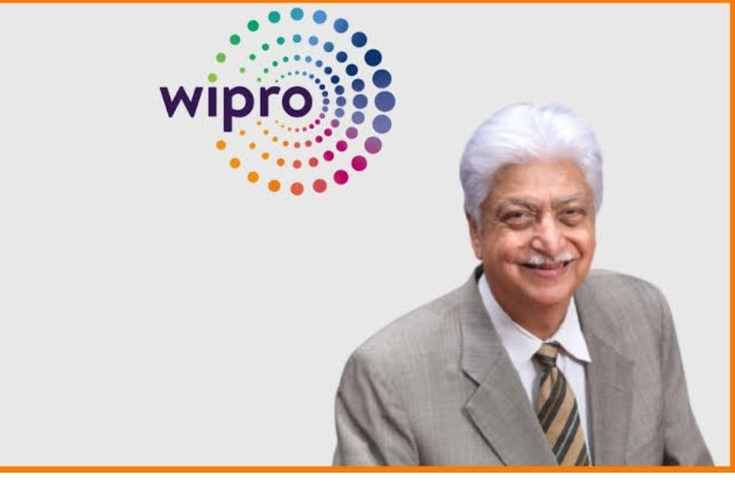

Slide 9
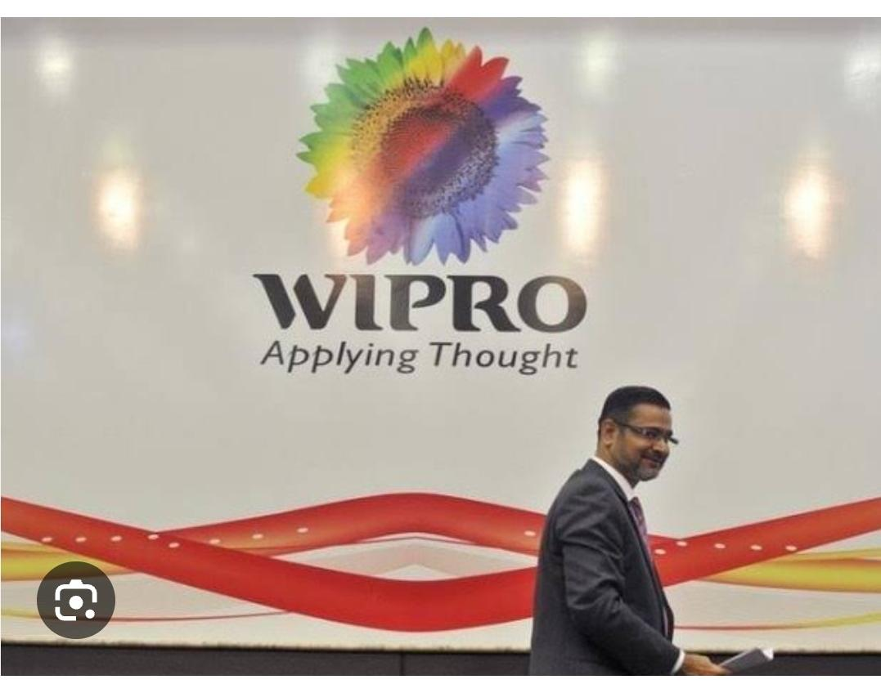

Slide 10
Part 1:BRAND STUDY,COMPETITOR ANALYSIS &BUYER ‘S/AUDIENCE’S PERSONA
# RESEARCH BRAND
Building new knowledge together
.Artificial intelligence –We apply machine learning and deep learning models to find simple and better solutions for complex technologies such as NLP,computer vision, predictive analytics, and more.
.Autonomous vehicles we are continuously seeking to improve the fundamental building blocks of Autonomous vehicles using advance technology.
.Block chain_ Our researchers are moving block chain towards being a more widely adopted technology across industries with relevant research projects such as provenance for digital supply chain, data consistency in sparsely connected systems, game theory for Smart contracts etc.

Slide 11
.Quantum computing _one of the high potential areas we seek to explore includes working on key projects like Quantum inspired algorithms for industry use cases and post- Quantum cryptography.
.5G_ The next generation of wireless technology, known as 5G,is undergoing intensive research and practice. We are working on key projects such as adaptive OTFS and precision location using cellular radio signals
What we do
.identify _ identify research topics or areas which are emerging and relevant to our customers.
.create_ Expand the research output to make it enterprise ready for consumption.
.Leverage _ leverage research to solve customers and in –house use cases.
.Exhibit _ Demonstrate research thought leadership through publication,speaker sessions and conferences.

Slide 12


Slide 13
Mission/vision/values
Mission;
Wipro mission is the quality (achieving through 6 sigma).
To be RF system solution provider, through it’s innovative research &design works for a new world of broadband wireless communication.
Vision ;
Focused on attaining leadership in the areas of business customers &people..
The company aims to be among the best IT company in India and the world.
It’s goals also included being the first choice among customers and employees.
Values ;
Be passionate with clients success.
Treat each person with respect.
Be global and responsible.

Slide 14
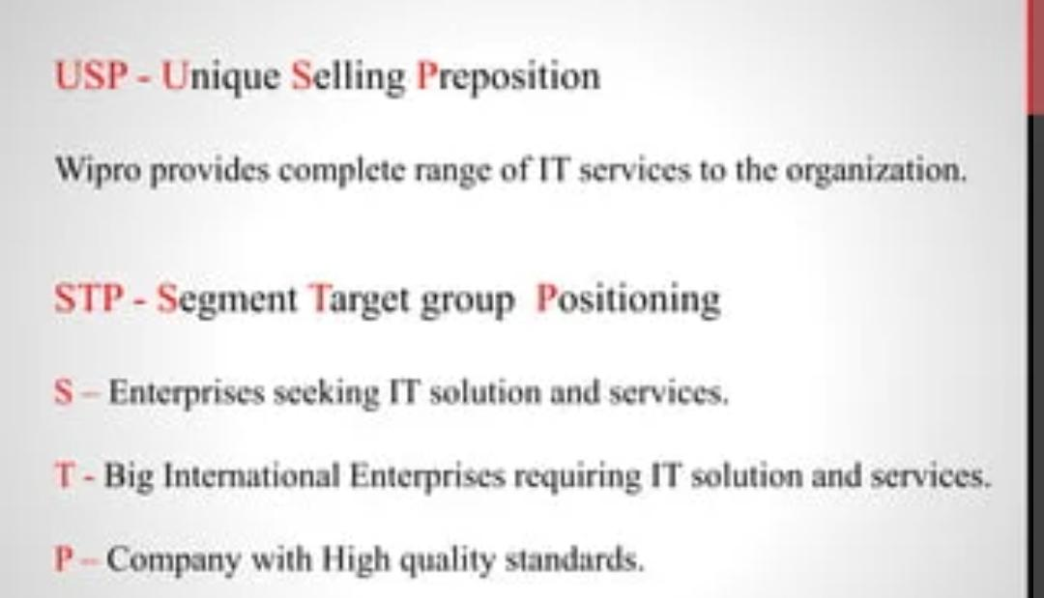
Unique selling point

Slide 15
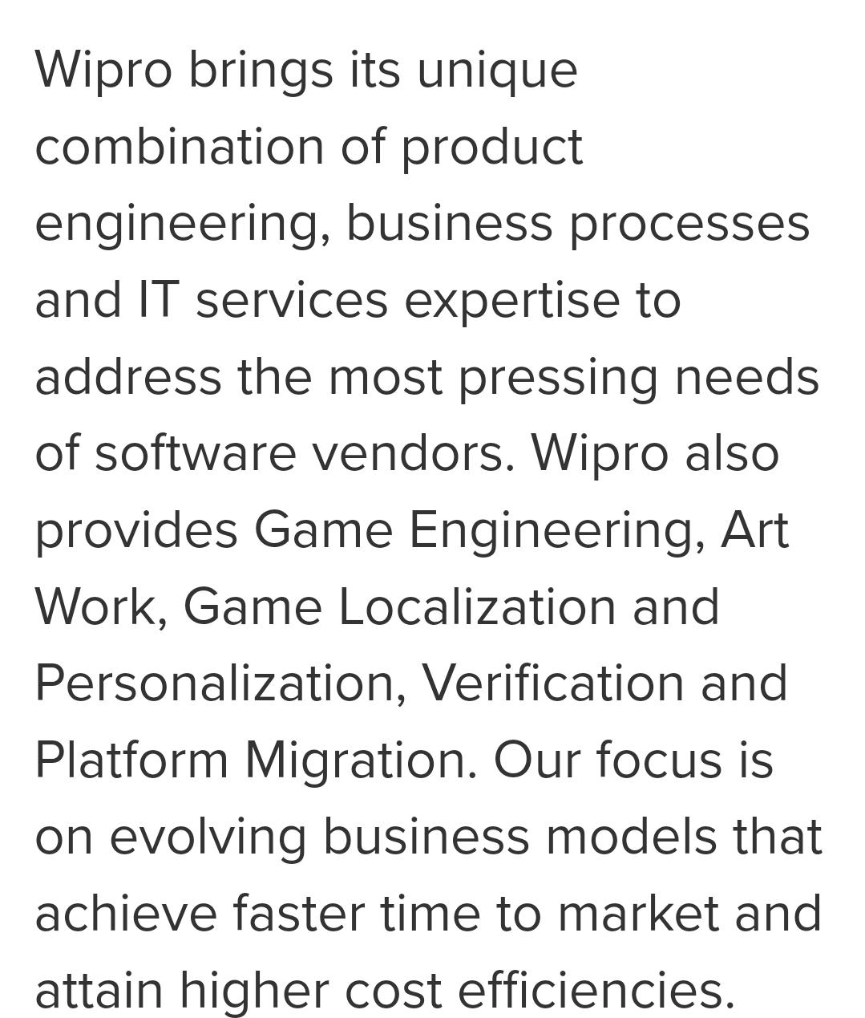

Slide 16
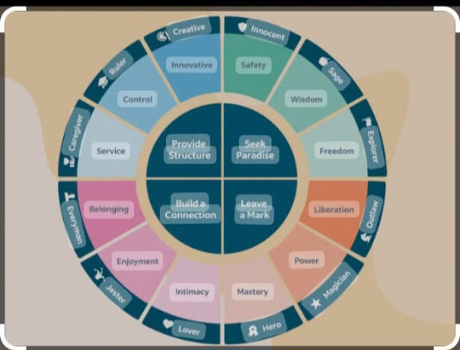
Analyze BRANDS Tone and identity:
The new brand identity marks Wipro's emergence as a trusted digital transformation partner to clients, delivering at a global scale with increasingly localized capabilities, and leveraging hyper _automation, robotics,cloud,analytics, cognitive, and emerging technologies.

Slide 17
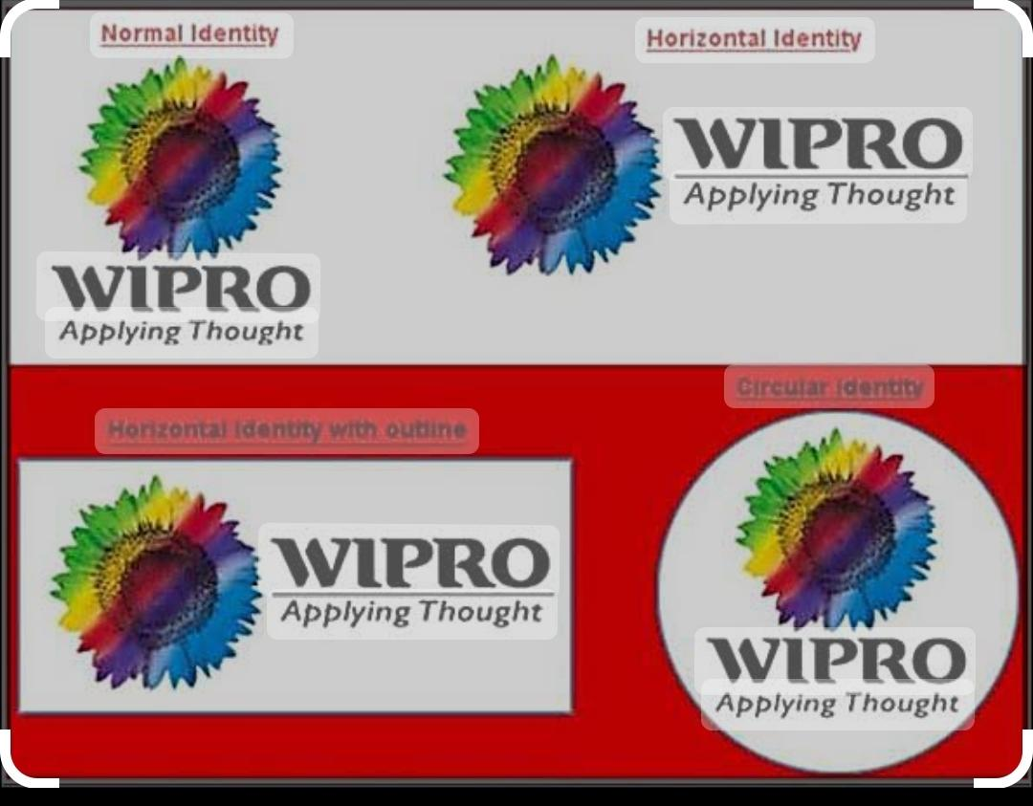

Slide 18

Brand product of wipro company

Slide 19
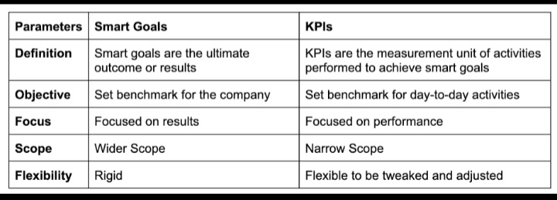
SET 5 SMART GOALS AND KPIS FOR THE SAME:

Slide 20
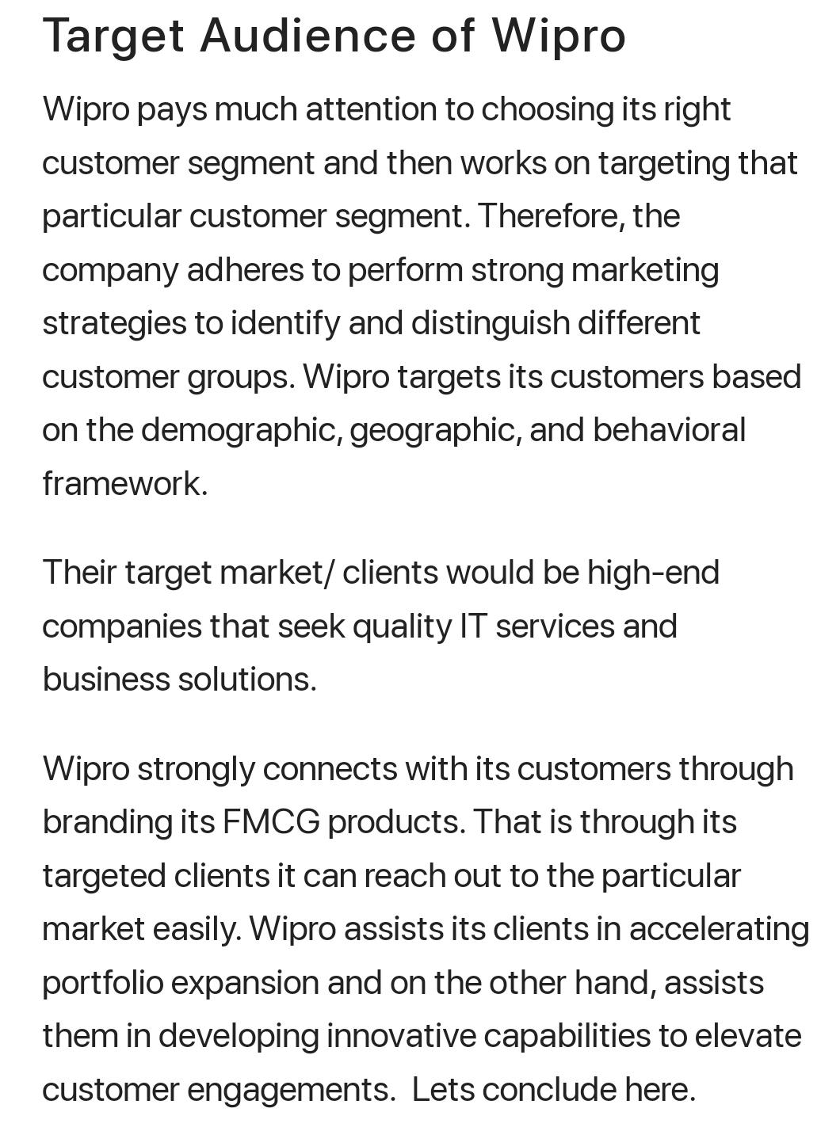
BUYER’S /AUDIENCE ‘S PERSONA;

Slide 21
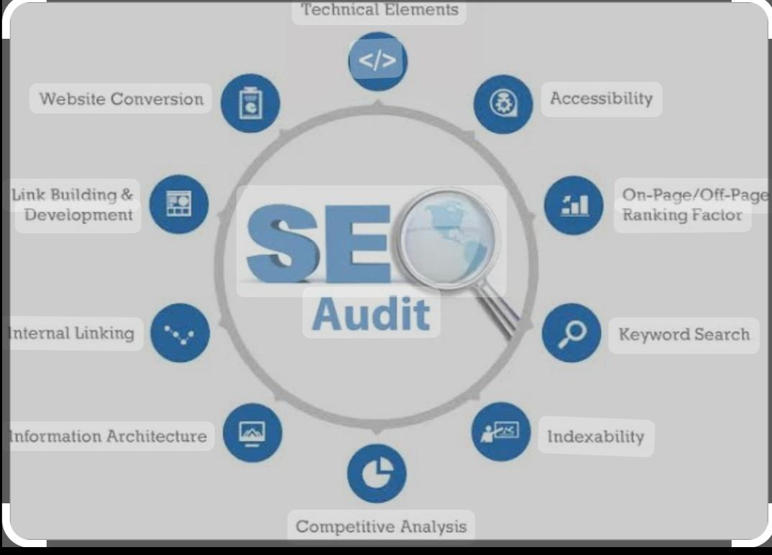
Part-2 SEO&KEYWORD RESEARCH
SEOAudit:

Slide 22
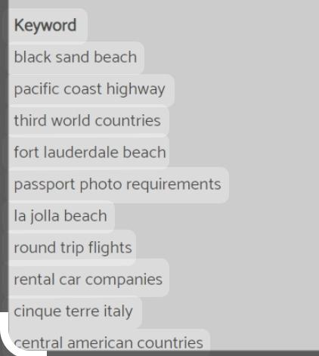
Key Word research

Slide 23
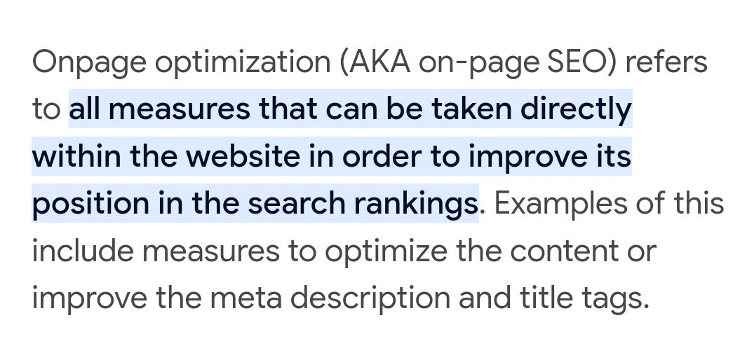
ON Page optimization

Slide 24
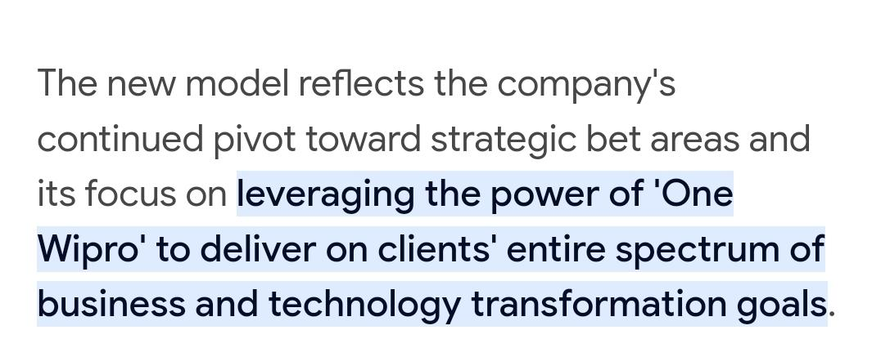
Part_3 content ideas and marketing strategies
Content idea generating &strategies

Slide 25
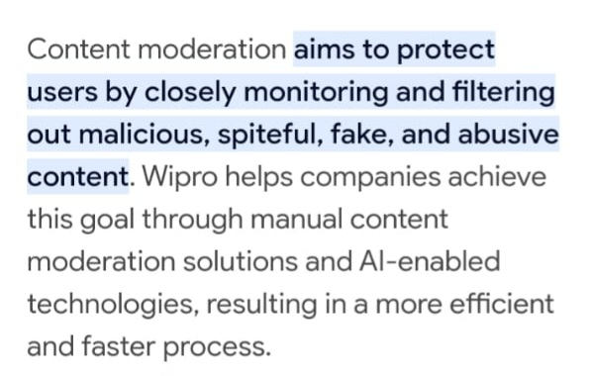
Part_4 content creation and curation
Post creation
Select content categories;

Slide 26
INSTAGRAM STORY
https://instagram.com/stories/tnan.dini2022/3212601848326809918?utm_source=ig_story_item_share&igshid=MTc4MmM1YmI2Ng==

